Slide 1
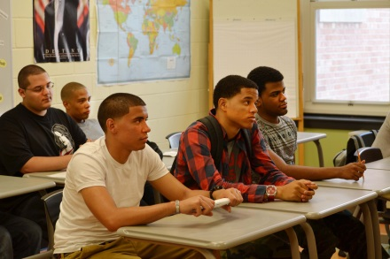
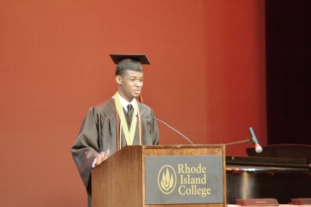
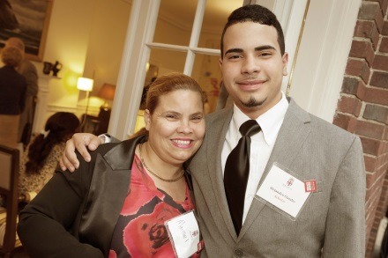
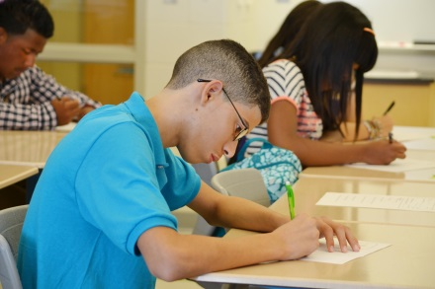
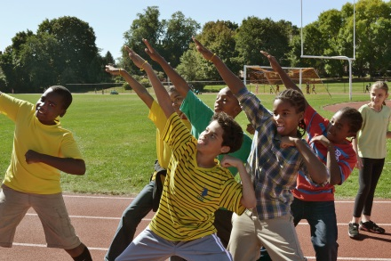

“Males of Color”
Initiative
A Presentation to the Providence School Board
May 11, 2015

Slide 2
Background
Council of Great City Schools “Males of Color” Pledge
Emerged from Trayvon Martin verdict in 2013
Pledge signed July 2014 by Superintendent Lusi and School Board President Oliveira
Providence Public School District (PPSD) joins 59 other urban school districts
Key Points:
  Recognition that academic achievement for Males of Color is well below what is expected for success in college and career
  Recognition that Males of Color are disproportionately suspended from school and exhibit higher chronic absenteeism
PPSD committed to examining how issues of race, language and culture affect the work of our district

Slide 3
Linkage with “My Brother’s Keeper”
President Obama’s “My Brother’s Keeper” Initiative
  Mayor Taveras/City of Providence joined in 2014
  Identifies persistent opportunity gaps faced by boys and young men of color
  Ensures all young people can reach their full potential
  Includes access to basic health, nutrition and high quality early education serves
  Relies on partnerships with local communities and police to reduce violence
  Goals include:
    Ensuring all students read at grade level by 3rd grade
    Ensuring all youth graduate high school college- and career-ready
    Ensuring all out of school youth are employed
    Ensuring all youth remain safe from violent crime

Slide 4
Data Analysis
Data compiled by the PPSD’s Office of Research, Planning and Accountability – special thanks to Dr. Marco Andrade
Measures data from the 2013-14 School Year
Includes:
  Population demographics of the School District
  Graduation Rates by Race and Gender
  Drop Out Rates by Race and Gender
  Attendance by Race and Gender
  Chronic Absenteeism by Race and Gender
  Out-of-School Suspension by Race and Gender
  AP Course Participation Rates by Race and Sex
  2013 ReadiStep/PSAT Participation Rates by Race and Gender
  AP Course Participation Rates by Race and Sex

Slide 5
PPSD Population, SY 2013 - 2014
Notes:
Other category consists of Native American, Multi-Racial and Pacific Islander, which accounts for less than 5% of PPSD’s total population
Total n = 24,686 (n = total PPSD population , excluding charters and home instruction)

Slide 6
2014 Graduation Rates by Race and Gender
Takeaways:
Black males have the lowest graduation rate of all the racial subgroups
Hispanic males have the third-lowest graduation rate of all the racial subgroups
Notes:
This chart represents 4-year graduation rates for the graduating class of 2014
Other category consists of Native American, Multi-Racial and Pacific Islander
These rates include home instruction and in-district charters (ACE, Times 2 ) students
Total n = 1270 (n = total graduates)
Notes:
Asian M 37 Asian F 47 Black M 115 Black F 120 Hispanic M 381 Hispanic F 403 White M 80 White F 56 Other M 16 Other Female 15

Slide 7
2014 Dropout Rates by Race and Gender
Takeaways:
Black and Hispanic males have the highest dropout rate of the four primary racial subgroups
Notes:
This chart represents 4-year graduation rates for the graduating class of 2014
Other category consists of Native American, Multi-Racial and Pacific Islander
These rates include home instruction and in-district charters (ACE, Times 2 ) students
Total n = 246 (n = total dropouts)
Notes:
Asian M 7 Asian F 4 Black M 32 Black F 17 Hispanic M 92 Hispanic F 63 White M 9 White F 11 Other M 7 Other Female 4

Slide 8
SY 2013-14 Attendance Rates by Race and Gender
Takeaways:
The gaps between Black and Hispanic males versus Black and Hispanic females is less than 1% point
The gap between Black and Hispanic male attendance and the highest attendance rate is
less than 3% points
Notes :
Native American and Pacific Islander data suppressed due to low numbers in population
Chart includes students enrolled at PPSD at any point in SY13-14
Total n = 24,686 (n = total PPSD population, excluding charters and home instruction)

Slide 9
SY 2013–14 Chronic Absence Rates by Race and Gender
Takeaways:
Hispanic males have the third-highest rate of chronic absence, behind multi-racial males and females
Black males have the second – lowest rate of chronic absence among males, and the fourth – lowest rate overall
Notes :
Native American and Pacific Islander data suppressed due to low numbers in population
Chart includes students enrolled at PPSD at any point in SY13-14
Total n = 23,858 (n = total PPSD population excluding charters and home instruction)
Notes:
Hispanic-M-2653 Chronic/8124 Enrolled K-12
Black-M-609 Chronic/2131 Enrolled K-12
Asian-M-152 Chronic/648 Enrolled K-12
White-M-345 Chronic/1111 Enrolled K-12
Multi Racial-M-133 Chronic/403 Enrolled K-12
Hispanic-F-2281 Chronic/7497 Enrolled K-12
Black-F-539 Chronic/2031 Enrolled K-12
Asian-F-134 Chronic/582 Enrolled K-12
White-F-296 Chronic/969 Enrolled K-12
Multi Racial-F-139 Chronic/362 Enrolled K-12

Slide 10
SY 2013 –14 Out of School Suspension Data by Race and Gender
Takeaways:
Black males are disproportionately suspended compared to other
racial subgroups. Hispanic males have the third-highest rates of OSS.
Notes :Native American and Pacific Islander data suppressed due to low numbers in population
Total n = 24,435 (n = total PPSD population excluding charters and home instruction)

Slide 11
2013 ReadiStep/PSAT Participation Rates by Race and Gender
Takeaways:
Hispanic males had the second-lowest participation rate for ReadiStep/PSAT
Notes:
Native American and Pacific Islander data suppressed due to low numbers in population
Students in grade 9 take the CollegeBoard ReadiStep; students in grades 10-11 take PSAT.
Total n = 6,969 (n = students grades 9-11, excluding charters and home instruction)

Slide 12
SY 2013 –14 AP Course Participation Rates by Race and Gender
Takeaways:
AP Course Participation is an indicator for future college enrollment.
Hispanic males had the lowest AP participation rates of all the subgroups
Black males had the third-lowest AP participation rates of all the subgroups
Notes:
Chart indicate rates of participation in at least 1 AP course
Native American and Pacific Islander data suppressed due to low numbers in population
Total n = 9,111 (n = total high school students ,excluding charters and home instruction)

Slide 13
Data Findings
Males of Color in Providence Schools:
  have lower graduation rates
  have higher drop out rates
  are disproportionately suspended from school
  have lower attendance than the district average
  are chronically absent more than other groups
  participate less in PSAT and other college prep tests
  participate less in Advanced Placement (college prep) courses

Slide 14
Males of Color Implementation Plan
  Draft Policy on “Institutionalized Racial Equity”
  Equality: Everyone gets a pair of shoes.
  Equity: Everyone gets a pair of shoes that fit.
  Acknowledgement that inequities exist in PPSD practices and procedures resulting in lower academic achievement for Males of Color
  Identify and eliminate racial inequities
  Racial Equity becomes an embedded value within the District

Slide 15
Males of Color Implementation Plan
  Institutional Equity (continued)
    School Board will consider adoption of Policy on Institutionalized Equity
    School Board will engage in broad community discussion of how race, language and culture affect the district
    Town hall forums and public hearings to gain feedback
  Data Collection
    Tracking progress of performance indicators; examples include:
      Academic Achievement and Attendance
      Graduation Rates and Drop Out Rates
      FAFSA Completions and PSAT Participation
      Student Discipline Referrals
      Special Education Referrals

Slide 16
Males of Color Implementation Plan
  Culturally Reflective Curriculum
    Coursework with greater cultural relevance
  Greater Role and Presence of Men of Color
    More involvement from parents and community leaders
    Recognition of the value of these important contributions
  Address Student Discipline
    Review of District “Code of Conduct” – IN PROGRESS
      Ensure policies are fair and equitable
    MOU between PPSD and Providence Police – COMPLETED
      Greater discretion for school principals
    Training for teachers and administrators – Restorative Practices

Slide 17
“Males of Color” Initiative
THANK YOU!

